Slide 1
Relational Database Management System

Slide 2
Course Objectives
Introduction of basic RDBMS concepts
Familiarization with SQL
Introduction to transaction processing
‹#›
Notes:
‹#›

Slide 3
Session Plan
Traditional Approach, Why DBMS, People Using DBMS
Data Models
RDBMS, Keys
ER Modeling
ERD Case Studies
Transforming an ER model to Relational Schema
Functional Dependencies
Normalization
Introduction to SQL and SQL Plus
DDL
DML (Till Order By)
Aggregate Functions
‹#›
Notes:
‹#›
In the traditional approach, information is stored in flat files which are maintained by the file system of OS.
Application programs go through the file system to access these flat files.

Slide 4
Session Plan
Group By and Having clause
Joins
Independent Sub Queries
Use of EXISTS and NOT EXISTS
Correlated Sub queries
Views
Transaction, OLTP, ACID properties
Serial Transactions and Serializability
Issues of Concurrency
Locking
‹#›
Notes:
‹#›
Data was stored in the form of records in the files.
Records consists of various fields which are delimited by a space , comma , tab etc.
Special characters used to mark the end of records and end of files.

Slide 5
Session Plan
Data Processing Modes
Traditional File Approach
Advantages of a DBMS
Three layers of abstraction
Users of DBMS
Database Models
Types of Databases
Relational Model Basics
Keys
Conceptual Design
ER Modelling
ER Modelling Notations
ERD Case study
Merits & Demerits of ER Modeling
‹#›
Notes:
‹#›
Services provided by a DBMS
Data management
Data definition
Transaction support
Concurrency control
Recovery
Security and integrity
Utilities- facilities like data import & export, user management, backup, performance analysis, logging & audit, physical storage control

Slide 6
Data processing
Data Collection
Recording
Sorting
Classifying
Calculating
Retrieving
Summarizing
Communicating
‹#›

Slide 7
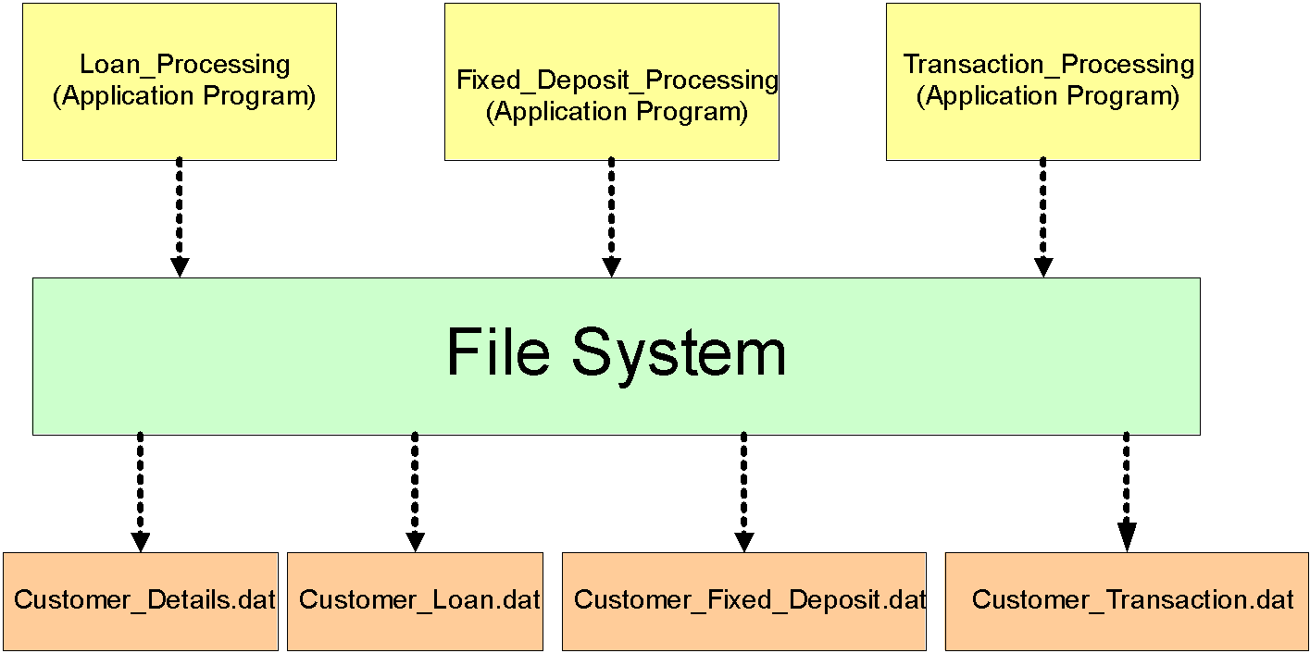
Traditional Method of Data Storage
‹#›

Slide 8
Ways of storing data in files – customer data
4176 Aniruddha Sarkar SBU1
4181 Manoj Saha SBU1
4183 Moushumi Dharchoudhury SBU1
4203 Suryanarayana D.V.S.S. SBU1
4204 Vivek Rai SBU1
Predefined length
4176 AniruddhaSarkar SBU1
4181 ManojSaha SBU1
4183 MoushumiDharchoudhury SBU1
4203 SuryanarayanaD.V.S. SBU1
4204 Vivek Rai SBU1
‹#›
Notes:
‹#›

Slide 9
Problems: Traditional approach
Data Security
Data Redundancy
Data Isolation
Program / Data Dependence
Lack of Flexibility
Concurrent Access Anomalies
‹#›

Slide 10
The Database Technology
Database
Computer based record-keeping system
Organized collection of interrelated (persistent) data
Records and maintains data
Database Management System
Collection of interrelated files and set of programs which allows users to access and
modify files
Primary Goal is to provide a convenient and efficient way to store, retrieve
and modify information
Layer of abstraction between the application programs and the file system
‹#›

Slide 11
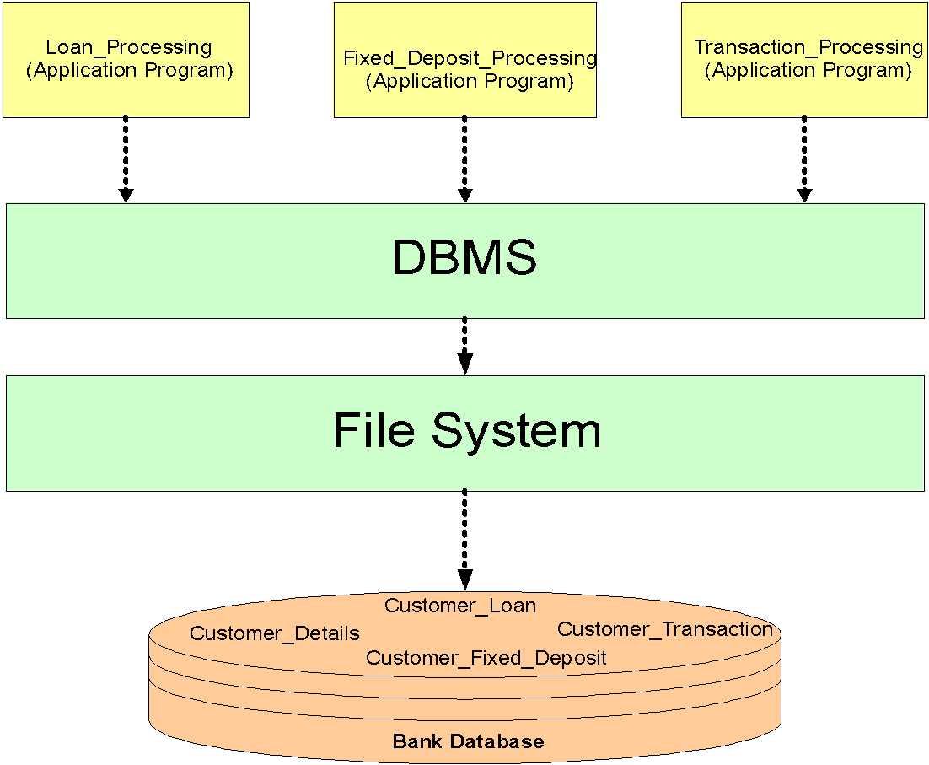
Where does the DBMS fit in?
‹#›

Slide 12
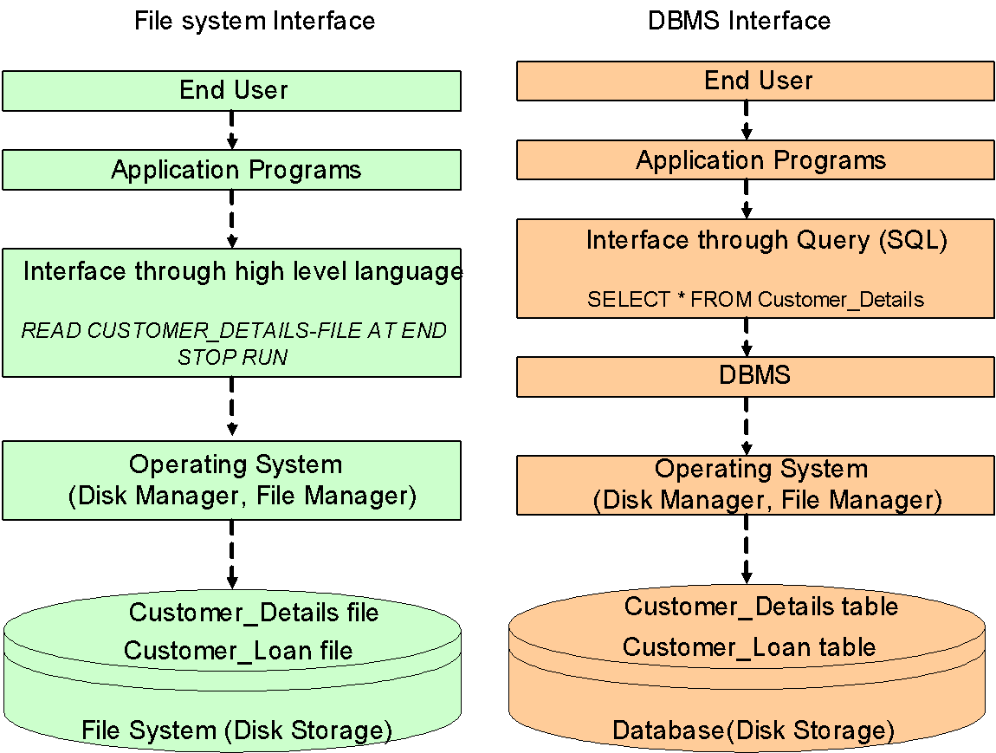
Difference Between File and DBMS Operations
‹#›

Slide 13
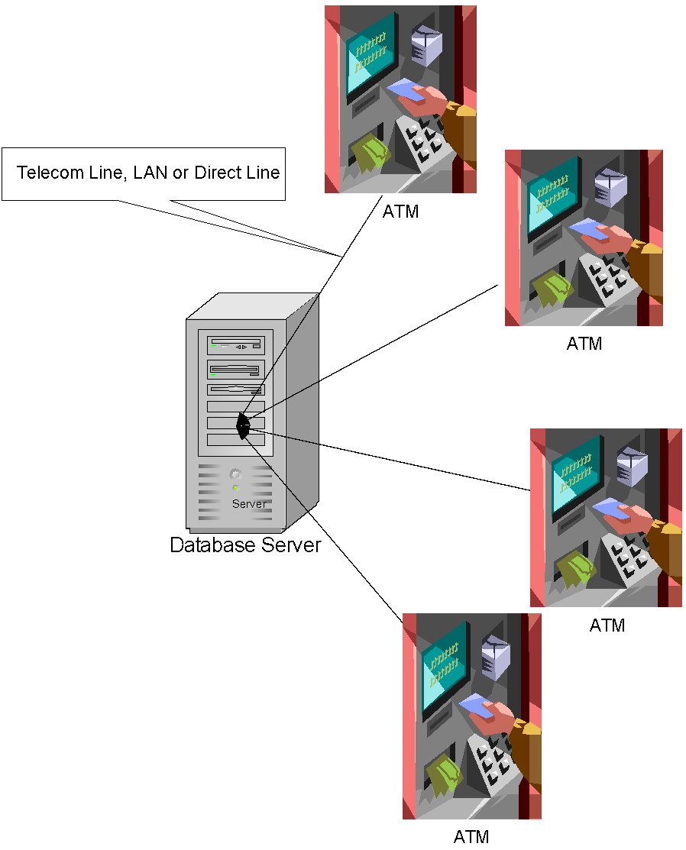
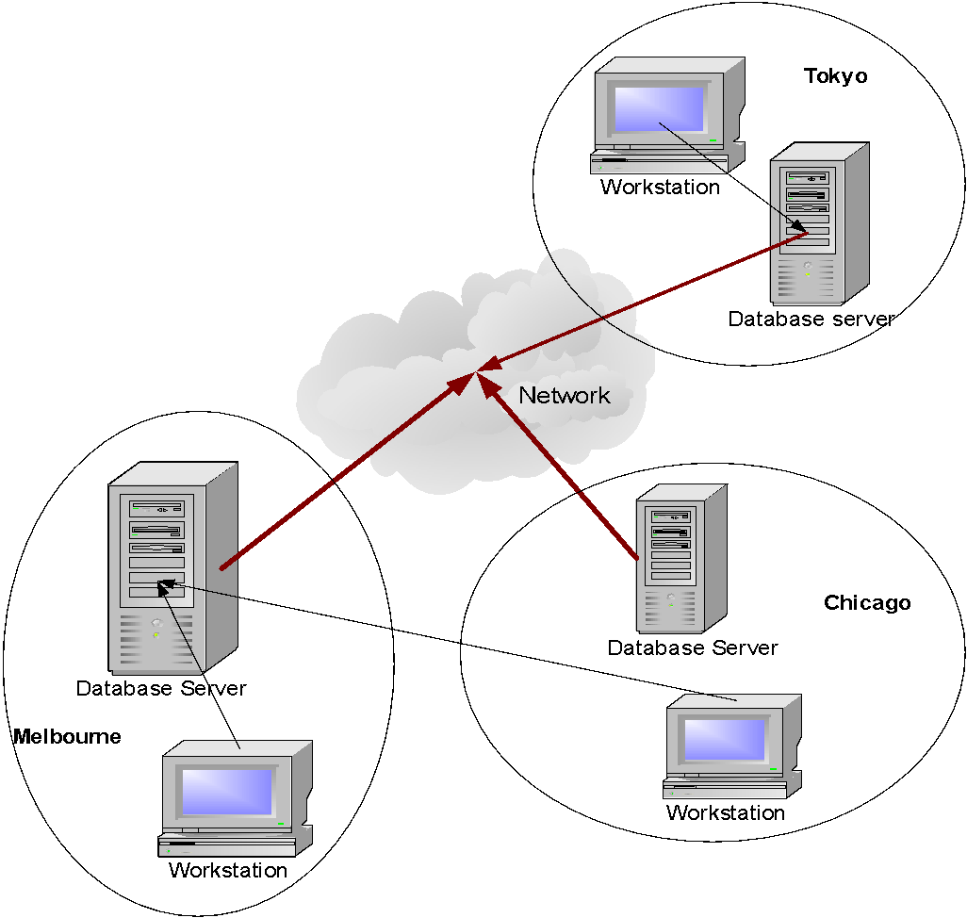
Types of Databases
Centralized Database
Distributed Database
‹#›
Notes:
‹#›
DBA is a key person and takes care of most administrative tasks as mentioned in the slide.
Database designers, design the database elements.
Application programmers, make use of the various database elements and write programs to retrieve data from them.
End users use the DBMS.

Slide 14
Three-layer Architecture
External / View Level
(Individual User View)
External
Schema A
External
Schema B
External
Schema C
Conceptual View
(Common User View)
Conceptual Schema
Internal Level
(Storage View)
Internal Schema
‹#›

Slide 15
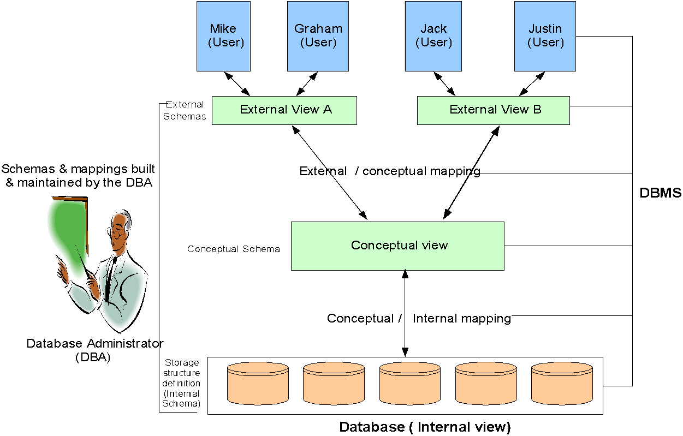
Detailed System Architecture
‹#›
Notes:
‹#›

Slide 16
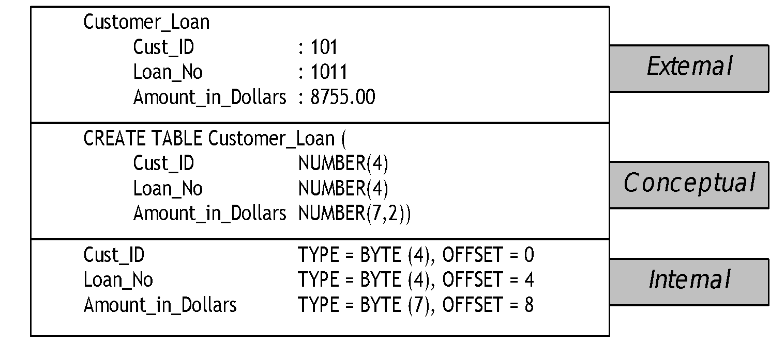
An example of the three levels
‹#›

Slide 17
Users of a DBMS
Database Administrator (DBA)
Managing information contents
Liaison with users
Enforcing security and integrity rules
Strategizing backup & recovery
Monitoring performance
Database designers
Application programmers
End users
‹#›

Slide 18
Advantages of a DBMS
Data independence
Reduction in data redundancy
Better security
Better flexibility
Effective data sharing
Enforces integrity constraints
Enables backup and recovery
‹#›

Slide 19
Data Models
Definition of data model :
A conceptual tool used to describe
Data
Data relationships
Data semantics
Consistency constraints
‹#›

Slide 20
Types of data models
Object based logical model
Entity relationship model
Record based logical model
Hierarchical data model
Network data model
Relational data model
‹#›

Slide 21
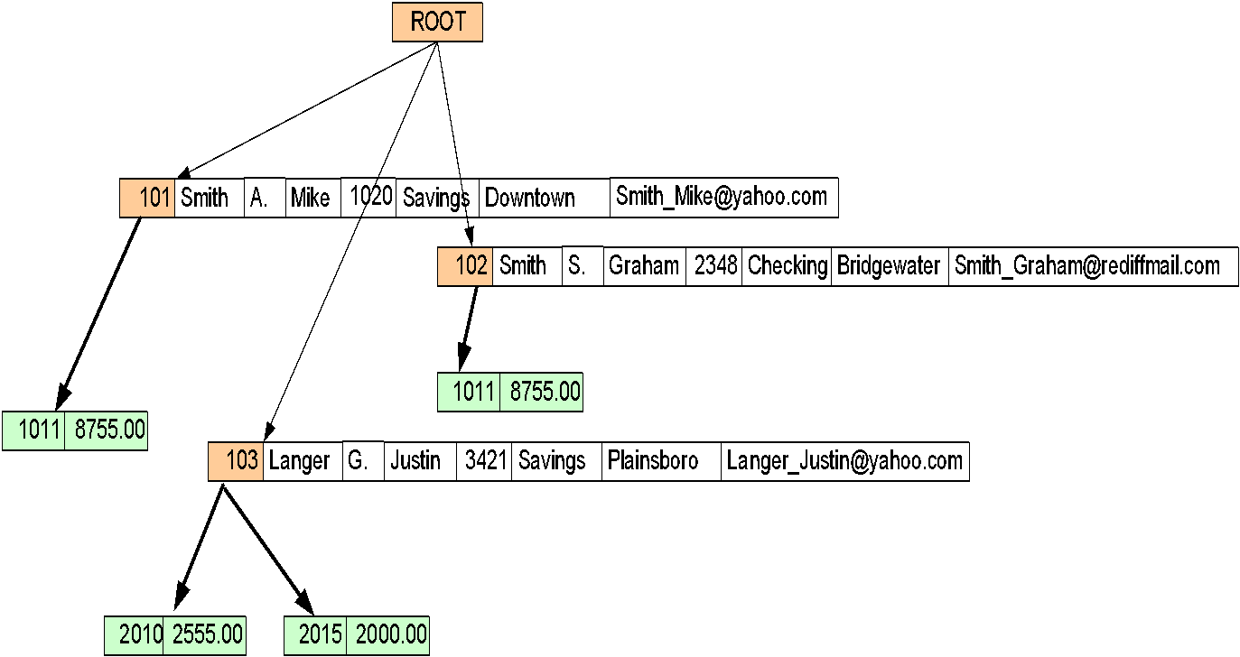
Record based data model – Hierarchical data model
‹#›

Slide 22
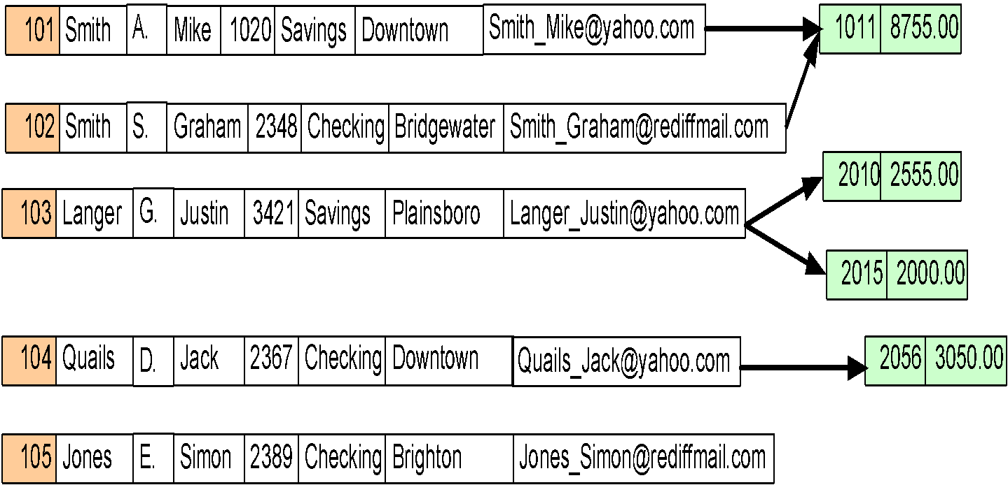
Record based data model – Network data model
‹#›

Slide 23
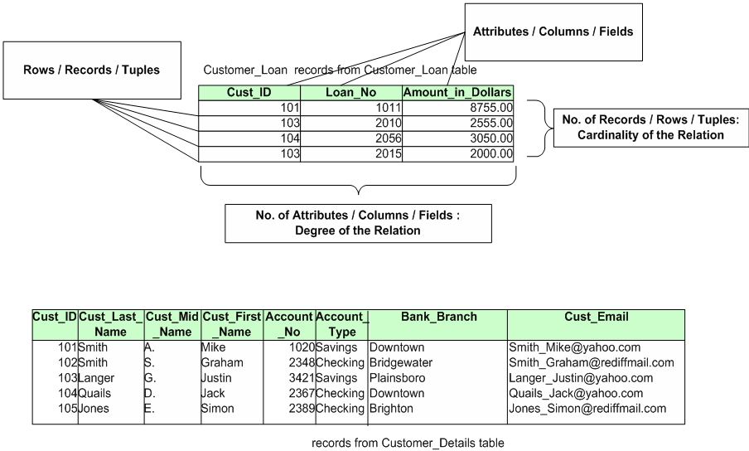
Record based data model – Relational data model
‹#›

Slide 24
Relational model basics
Data is viewed as existing in two dimensional tables known as relations
A relation (table) consists of unique attributes (columns) and tuples (rows)
Tuples are unique
Sometimes the value to be inserted into a particular cell may be unknown, or it may have no value. This is represented by a NULL
Null is not the same as zero, blank or an empty string
Relational Database: Any database whose logical organization is based on relational data model.
RDBMS: A DBMS that manages the relational database.
‹#›

Slide 25
Keys
Candidate key
A Candidate key is a set of one or more attributes(minimal) that can uniquely identify a row in a given table.
Primary Key
During the creation of the table, the Database Designer chooses one of the Candidate Key from amongst the several available, to uniquely identify row in the given table.
Alternate Key
The candidate key that is chosen to perform the identification task is called the primary key and the remaining candidate keys are known as alternate keys.
No of Alternate Keys = No of Candidate Keys - 1
Super Key
Any superset of a candidate Key is a super key.
‹#›

Slide 26
Key and Non-key Attributes
Key Attributes
The attributes that participate in the Candidate key are Key Attributes
Non-Key Attributes
The attributes other than the Candidate Key attributes in a table/relation are called Non-Key attributes.
OR
The attributes which do not participate in the Candidate key.
‹#›

Slide 27
Example
Given a relation
Trainee(Empno, FirstName, LastName, Email, PhoneNo)
Candidate key:
{Empno},{Email},{PhoneNo},{FirstName,LastName}
Primary key:
{Empno}
Alternate Key:
{Email},{PhoneNo},{FirstName,LastName}
Super Key:
{Empno},{Empno,PhoneNo},{Email,FirstName}, etc…
‹#›
Notes:
‹#›

Slide 28
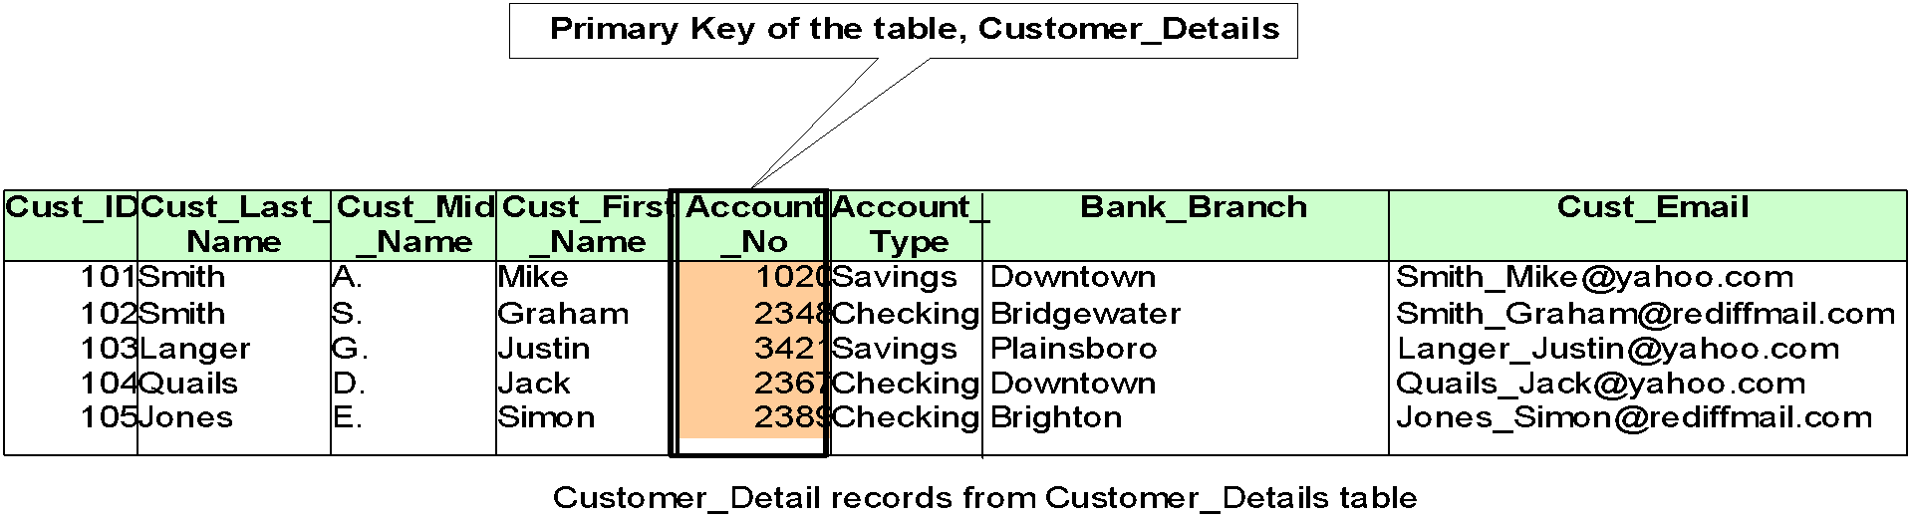
Choosing a Primary key from Candidate keys
Give preference to numeric column(s)
Give preference to single attribute
Give preference to minimal composite key
‹#›

Slide 29
Foreign Key
Foreign key
A Foreign Key is a set of attribute (s) whose values are required to match values of a column in the same or another table.
DEPT EMP
(Parent /Master/Referenced Table) (Child /Referencing Table)
Point to remember
Foreign key values do not (usually) have to be unique.
Foreign keys can also be null .
DeptNo | DName
D1 | IVS
D2 | ENR
EmpNo | EName | EDeptNo
1001 | Elsa | D1
1002 | John | D2
1003 | Maria | Null
1004 | Maida | D1
‹#›

Slide 30
Foreign Key
Foreign key
Points to remember
A Foreign Key is a set of attributes of a table, whose values are required to match values of some Candidate Key in the same or another table
The constraint that values of a given Foreign Key must match the values of the corresponding Candidate Key is known as Referential constraint
A table which has a Foreign Key referring to its own Candidate Key is known as Self-Referencing table
‹#›

Slide 31
Entity Relationship modeling

Slide 32
Database Design Techniques
Top down Approach
E R Modeling
Bottom Up approach
Normalization
‹#›

Slide 33
ER modeling
ER modeling: A graphical technique for understanding and organizing the data independent of the actual database implementation.
Entity: Any thing that may have an independent existence and about which we intend to collect data.
Also known as Entity type. E.g.: Trainee
Entity instance: a particular member of the entity type e.g. a particular trainee
Attributes: Properties/characteristics that describe entities.eg: Trainee name, Batchname, DOB, Address, etc.
Relationships: Associations between entities.E.g.: Trainee belongs to a Batch
‹#›

Slide 34
Attributes
The set of possible values for an attribute is called the domain of the attribute
Example:
The domain of attribute marital status is having four values: single, married, divorced or widowed.
The domain of the attribute month is having twelve values ranging from January to December.
Key attribute: The attribute (or combination of attributes) that is unique for every entity instance
E.g.: the account number of an account, the employee id of an employee etc.
If the key consists of two or more attributes in combination, it is called a composite key
‹#›
Notes:
‹#›
Though logically data is viewed as existing in the form of two dimensional tables, actually, the data is stored under the file system only.
The RDBMS provides an abstraction on top of the file system and gives an illusion that data resides in the form of tables.

Slide 35
Simple Vs composite attribute
Simple attribute: cannot be divided into simpler components
E.g.: age of an employee
Composite attribute: can be split into components
E.g.: Date of joining of the employee.
Can be split into day, month and year
‹#›

Slide 36
Single Vs Multi-valued Attributes
Single valued : can take on only a single value for each entity instance
E.g.: age of employee. There can be only one value for this.
Multi-valued: can take up many values
E.g.: skill set of employee
‹#›

Slide 37
Stored Vs Derived attribute
Stored Attribute: Attribute that need to be stored permanently.
E.g.: name of an employee
Derived Attribute: Attribute that can be calculated based on other attributes.
E.g. : years of service of employee can be calculated from date of joining and current date
‹#›

Slide 38
Regular Vs. Weak entity type
Regular Entity: Entity that has its own key attribute (s).
E.g.: Employee, student ,customer, policy holder etc.
Weak entity: Entity that depends on other entity for its existence and doesn’t have key attribute (s) of its own
E.g. : spouse of employee
‹#›

Slide 39
Relationships
A relationship type between two entity types defines the set of all associations between these entity types
Each instance of the relationship between members of these entity types is called a relationship instance
E.g if Works-for is the relationship between the Employee entity and the department entity, then Rohan works-for IVS department,
Riya works – for ENR department ..etc are relationship instances of the relationship, works-for
‹#›

Slide 40
Degree of a Relationship
Degree: the number of entity types involved
One Unary
Two Binary
Three Ternary
E.g.: employee manager-of employee is unary
employee works-for department is binary
customer purchase item, shop keeper is a ternary relationship
‹#›

Slide 41
Cardinality
Relationships can have different connectivity
one-to-one (1:1)
one-to-many (1:N)
many-to- One (M:1)
many-to-many (M:N)
E.g.:
Employee head-of department (1:1)
Lecturer offers course (1:N) assuming a course is taught by a single lecturer
Student enrolls course (M:N)
‹#›

Slide 42
Relationship Participation
Total : Every entity instance must be connected through the relationship to another instance of the other participating entity types
Partial: All instances need not participate
E.g.: Employee Head-of Department
Employee: partial
Department: total
‹#›

Slide 43


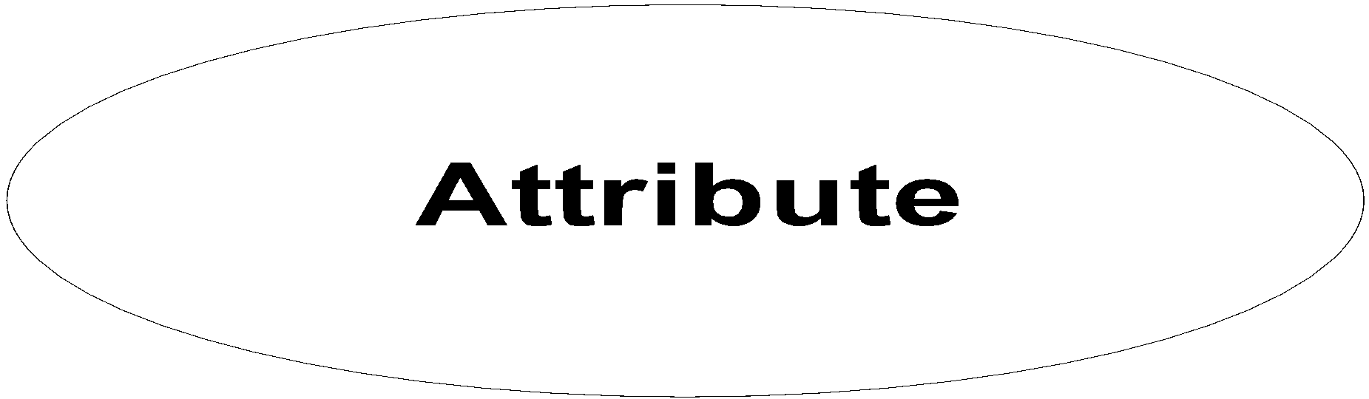


ER Modeling -Notations
 | An Entity is an object or concept about which business user wants to store information.
 | A weak Entity is dependent on another Entity to exist. Example Order Item depends upon Order Number for its existence. Without Order Number it is impossible to identify Order Item uniquely.
 | Attributes are the properties or characteristics of an Entity
 | A key attribute is the unique, distinguishing characteristic of the Entity
 | A multi-valued attribute can have more than one value. For example, an employee Entity can have multiple skill values.
‹#›

Slide 44



ER Modeling -Notations
 | A derived attribute is based on another attribute. For example, an employee's monthly salary is based on the employee's basic salary and House rent allowance.
 | Relationships illustrate how two entities share information in the database structure.
 | To connect a weak Entity with others, you should use a weak relationship notation.
‹#›

Slide 45
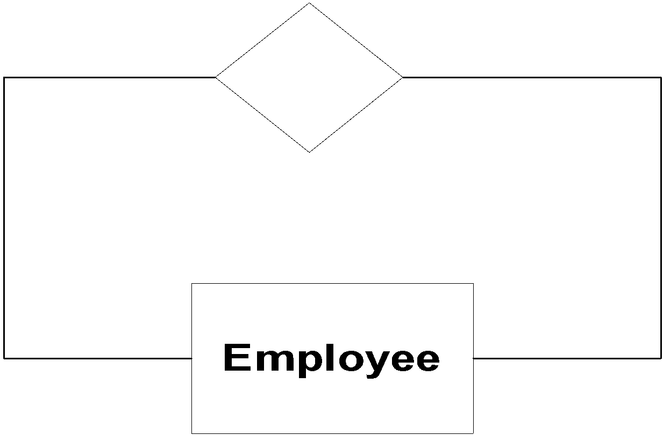
ER Modeling -Notations
Customer
 | Cardinality specifies how many instances of an Entity relate to one instance of another Entity. M,N both represent ‘MANY’ and 1 represents ‘ONE’ Cardinality
1
N
1
M
Account
Transaction
 | In some cases, entities can be self-linked. For example, employees can supervise other employees
‹#›
Notes:
‹#›

Slide 46
Attributes
DOB
Name
Address
E#
Designation
Employee
‹#›

Slide 47
Key attribute
DOB
Name
Address
E#
Designation
Employee
The key attribute
is underlined
‹#›
Notes:
‹#›

Slide 48
Multivalued Attribute
DOB
Address
Name
Designation
E#
Employee
skill set
‹#›

Slide 49
Composite attribute
floor
building
DOB
Name
Address
E#
Designation
Employee
‹#›

Slide 50
Relationship
enrols
in
student
course
‹#›
Notes:
‹#›

Slide 51
Unary Relationship
Manages
Employee
‹#›

Slide 52
Role names
Role names may be added to make the meaning more explicit
subordinate
Manages
Employee
Manager
‹#›

Slide 53
Binary Relationship
Works
for
Employee
Department
‹#›

Slide 54
Ternary Relationship
Medicine
Doctor
Prescription
Patient
‹#›

Slide 55
Relationship participation
1
head
of
1
Employee
department
Total
partial
‹#›

Slide 56
Attributes of a Relationship
Medicine
Number of days
dosage
Doctor
Prescription
Patient
‹#›

Slide 57
Weak entity
E#
id
name
1
has
N
dependant
Employee
The dependant entity is represented by a double lined rectangle and the identifying relationship by a double lined diamond
‹#›
Notes:
‹#›

Slide 58
Case Study – ER Model For a college DB
Assumptions :
A college contains many departments
Each department can offer any number of courses
Many instructors can work in a department
An instructor can work only in one department
For each department there is a Head
An instructor can be head of only one department
Each instructor can take any number of courses
A course can be taken by only one instructor
A student can enroll for any number of courses
Each course can have any number of students
‹#›

Slide 59
Steps in ER Modeling
Identify the Entities
Find relationships
Identify the key attributes for every Entity
Identify other relevant attributes
Draw complete E-R diagram with all attributes including Primary Key
Review your results with your Business users
‹#›

Slide 60
Steps in ER Modeling
Step 1: Identify the Entities
DEPARTMENT
STUDENT
COURSE
INSTRUCTOR
‹#›

Slide 61
Steps in ER Modeling
Step 2: Find the relationships
One course is enrolled by multiple students and one student enrolls for multiple courses, hence the cardinality between course and student is Many to Many.
The department offers many courses and each course belongs to only one department, hence the cardinality between department and course is One to Many.
One department has multiple instructors and one instructor belongs to one and only one department , hence the cardinality between department and instructor is one to Many.
Each department there is a “Head of department” and one instructor is “Head of department “,hence the cardinality is one to one .
One course is taught by only one instructor, but the instructor teaches many courses, hence the cardinality between course and instructor is many to one.
‹#›

Slide 62
Steps in ER Modeling
Step 3: Identify the key attributes
Deptname is the key attribute for the Entity “Department”, as it identifies the
Department uniquely.
Course# (CourseId) is the key attribute for “Course” Entity.
Student# (Student Number) is the key attribute for “Student” Entity.
Instructor Name is the key attribute for “Instructor” Entity.
Step 4: Identify other relevant attributes
For the department entity, the relevant attribute is location
For course entity, course name,duration,prerequisite
For instructor entity, room#, telephone#
For student entity, student name, date of birth
‹#›

Slide 63

Case Study – Banking Business Scenario
Assumptions :
There are multiple banks and each bank has many branches. Each branch has multiple customers
Customers have various types of accounts
Some Customers also had taken different types of loans from these bank branches
One customer can have multiple accounts and Loans
‹#›

Slide 64
Steps in ER Modeling
Step 1: Identify the Entities
BANK
BRANCH
LOAN
ACCOUNT
CUSTOMER.
‹#›

Slide 65
Steps in ER Modeling
Step 2: Find the relationships
One Bank has many branches and each branch belongs to only one bank, hence the cardinality between Bank and Branch is One to Many.
One Branch offers many loans and each loan is associated with one branch, hence the cardinality between Branch and Loan is One to Many.
One Branch maintains multiple accounts and each account is associated to one and
only one Branch, hence the cardinality between Branch and Account is One to Many
One Loan can be availed by multiple customers, and each Customer can avail multiple
loans, hence the cardinality between Loan and Customer is Many to Many.
One Customer can hold multiple accounts, and each Account can be held by multiple
Customers, hence the cardinality between Customer and Account is Many to Many
‹#›

Slide 66
Steps in ER Modeling
Step 3: Identify the key attributes
BankCode (Bank Code) is the key attribute for the Entity “Bank”, as it identifies the bank uniquely
Branch# (Branch Number) is the key attribute for “Branch” Entity
Customer# (Customer Number) is the key attribute for “Customer” Entity
Loan# (Loan Number) is the key attribute for “Loan” Entity
Account No (Account Number) is the key attribute for “Account” Entity
‹#›

Slide 67
Steps in ER Modeling
Step 4: Identify other relevant attributes
For the “Bank” Entity, the relevant attributes other than “BankCode” would be “Name” and “Address”
For the “Branch” Entity, the relevant attributes other than “Branch#” would be “Name” and “Address”
For the “Loan” Entity, the relevant attribute other than “Loan#” would be “Loan Type”
For the “Account” Entity, the relevant attribute other than “Account No” would be “Account Type”
For the “Customer” Entity, the relevant attributes other than “Customer#” would be “Name”, “Telephone#” and “Address”
‹#›

Slide 68
Merits and Demerits of ER Modeling
Merits
Easy to understand. Represented in Business Users Language. Can be understood by non-technical specialist.
Intuitive and helps in Physical Database creation.
Can be generalized and specialized based on needs.
Can help in database design.
Gives a higher level description of the system.
Demerits
Physical design derived from E-R Model may have some amount of ambiguities or inconsistency.
Sometime diagrams may lead to misinterpretations
‹#›

Slide 69
Summary
Most of the application errors are because of miscommunication between the application user and the designer and between the designer and the developer.
It is always better to represent business findings in terms of picture to avoid miscommunication
It is practically impossible to review the complete requirement document by business users.
An E-R diagram is one of the many ways to represent business findings in pictorial format.
E-R Modeling will also help the database design
E-R modeling has some amount of inconsistency and anomalies associated with it.
‹#›

